Slide 1
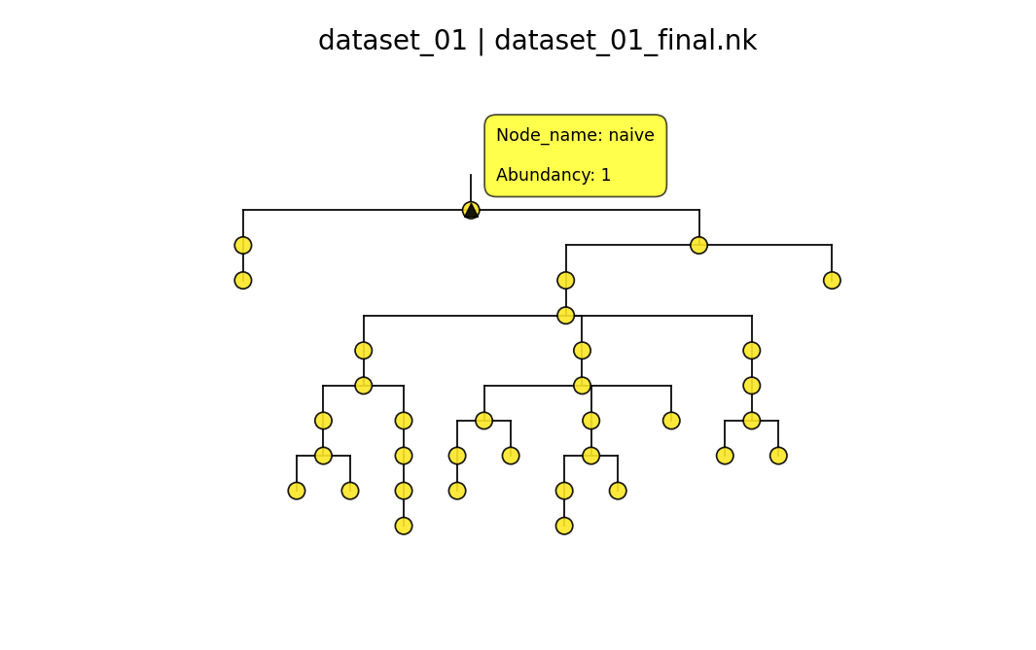
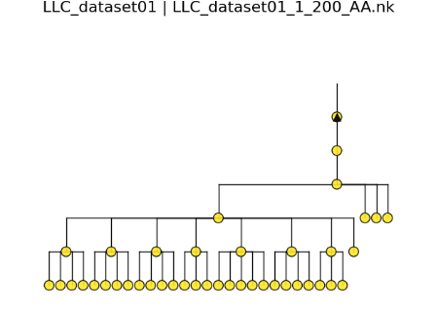
Features based New_Amino-acid based

Slide 2
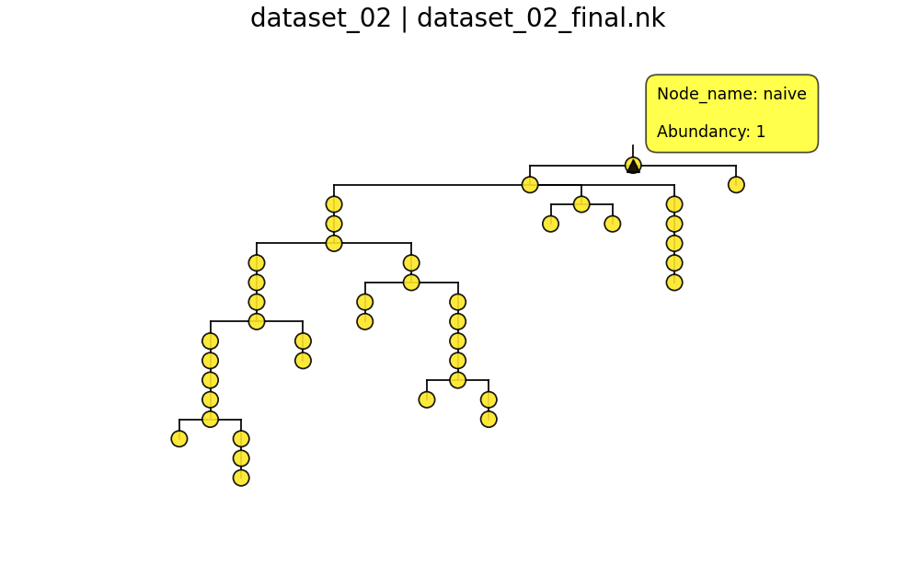
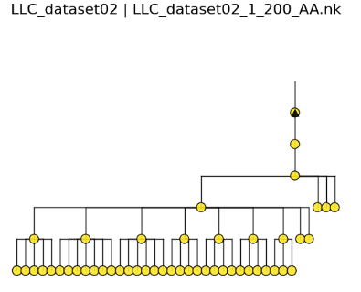
Features based Amino-acid based

Slide 3
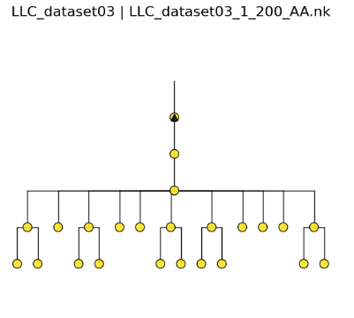
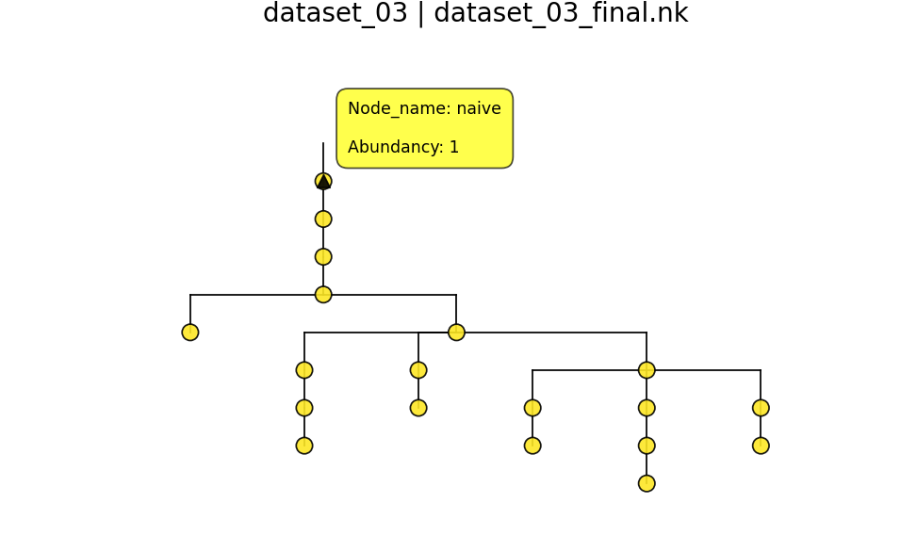
Features based Amino-acid based

Slide 4
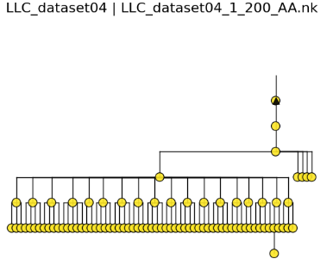
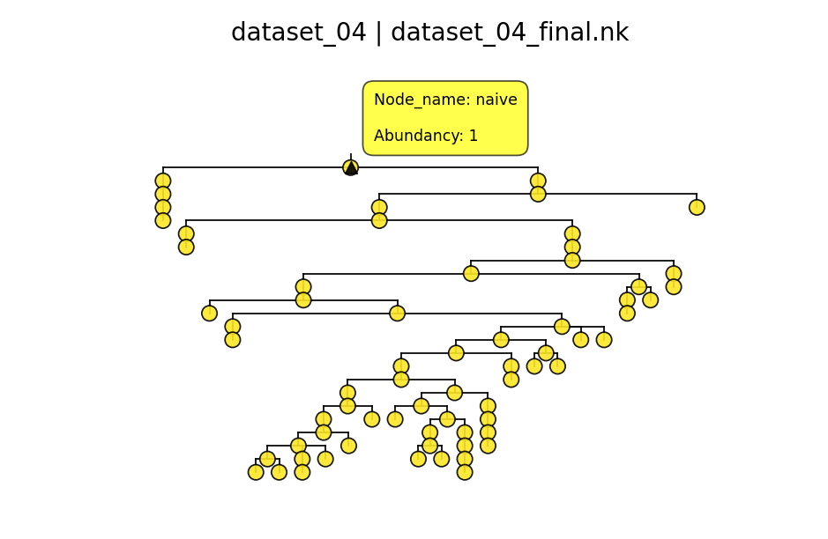
Features based Amino-acid based

Slide 5
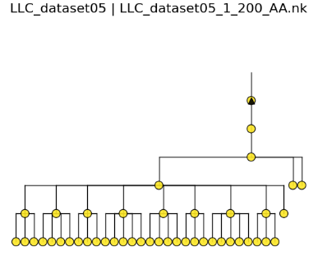
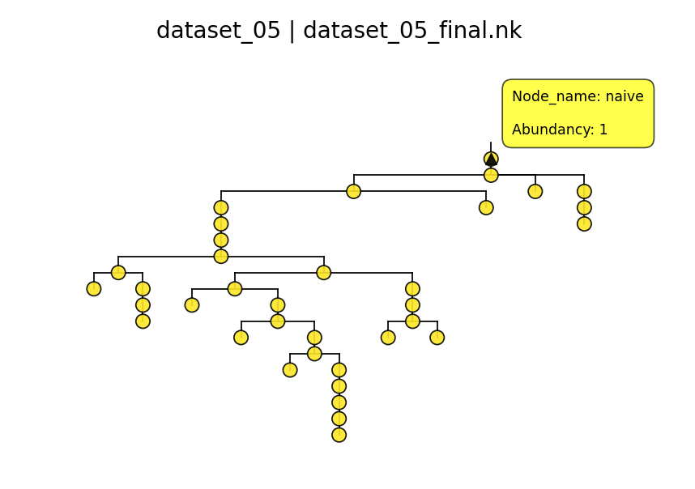
Features based Amino-acid based

Slide 6
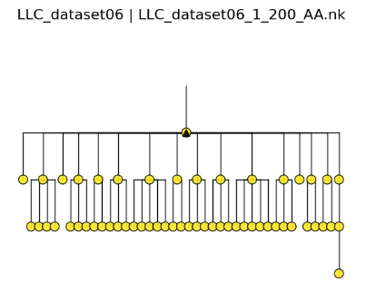
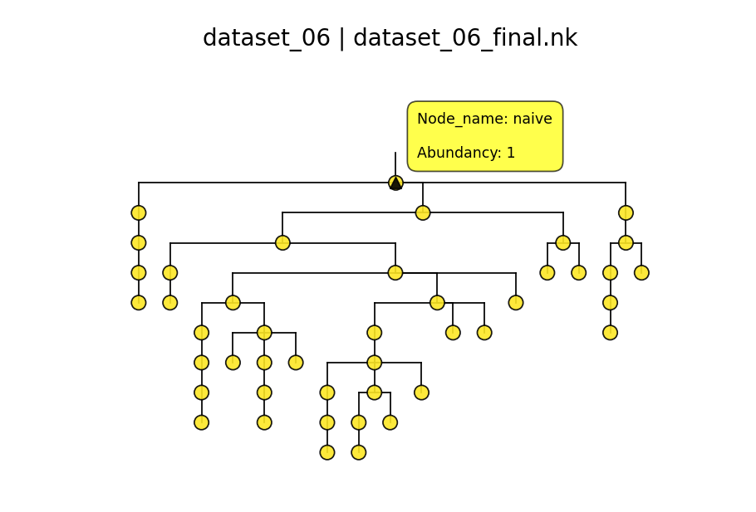
Features based Amino-acid based

Slide 7
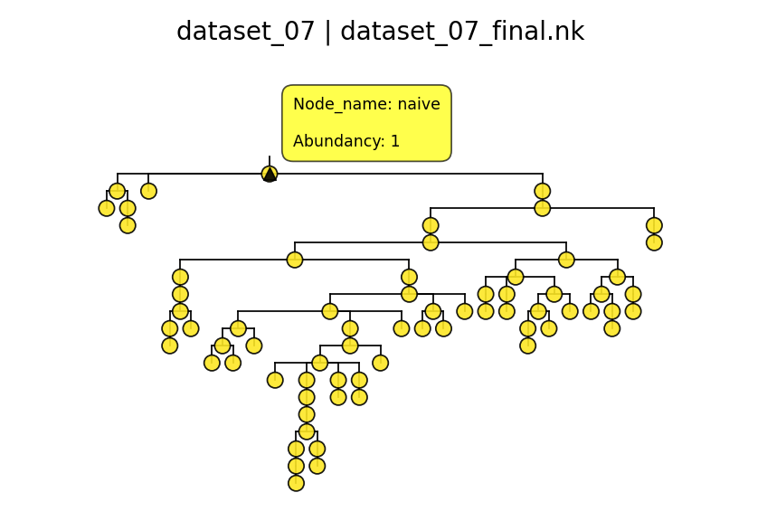
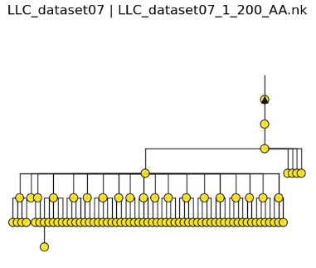
Features based Amino-acid based

Slide 8
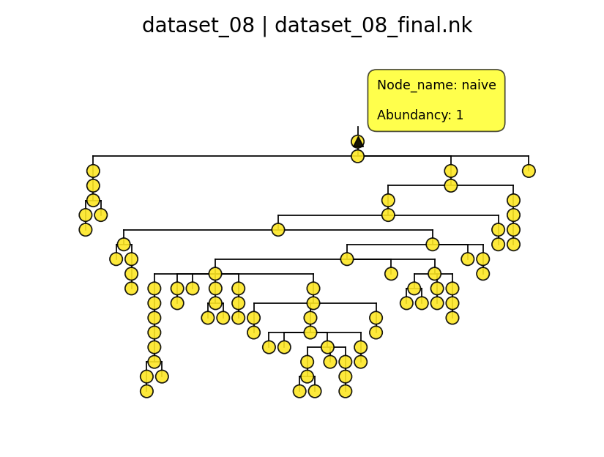
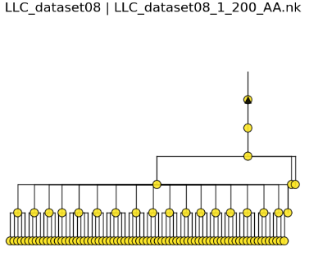
Features based Amino-acid based

Slide 9
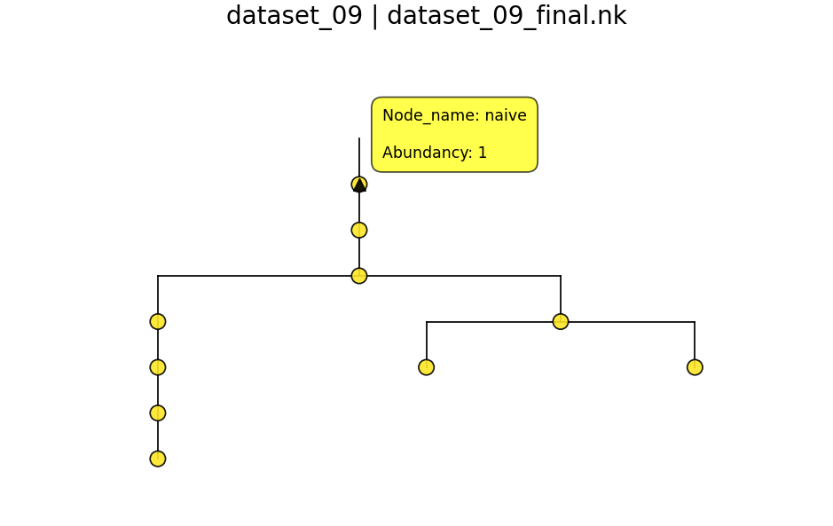
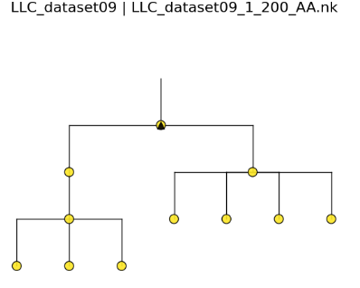
Features based Amino-acid based

Slide 10
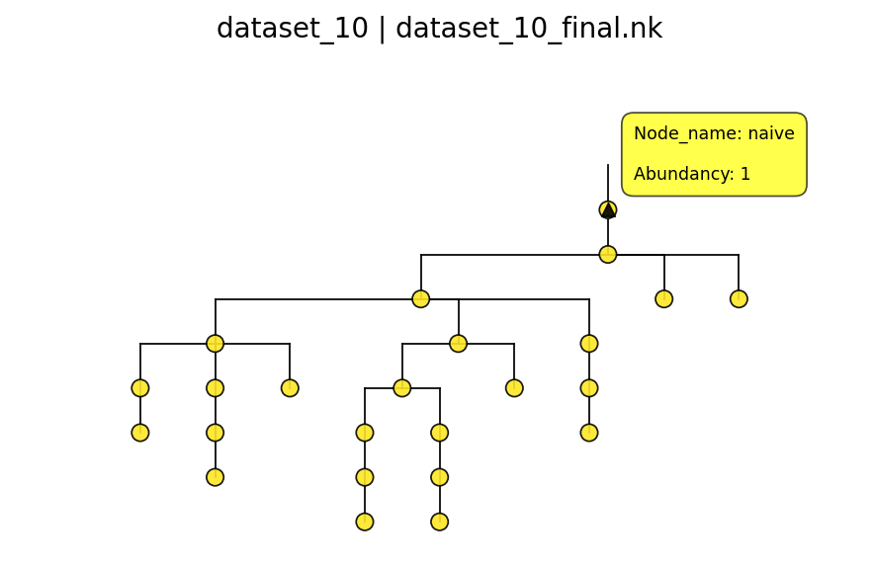
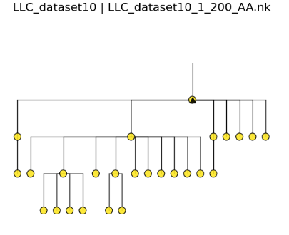
Features based Amino-acid based

Slide 11
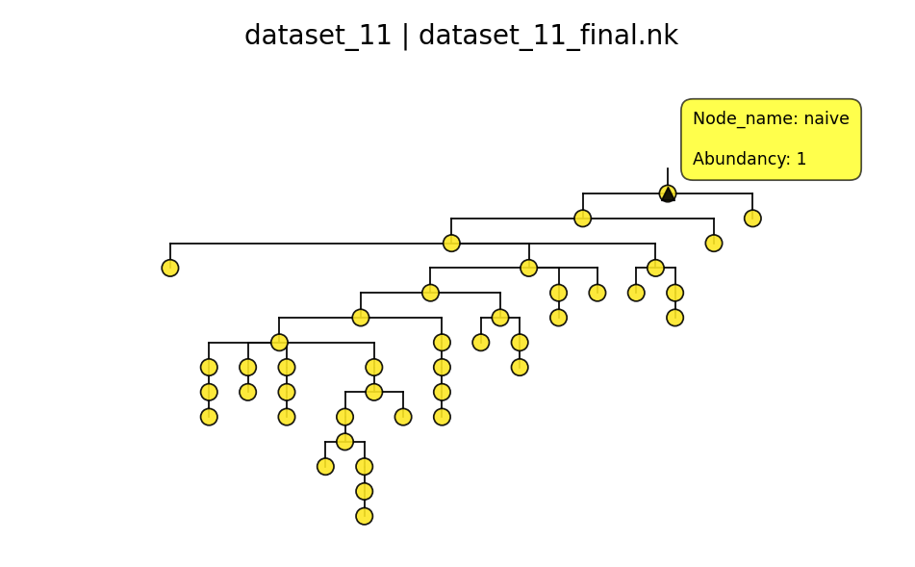
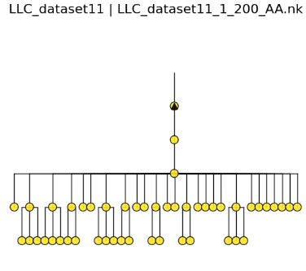
Features based Amino-acid based

Slide 12
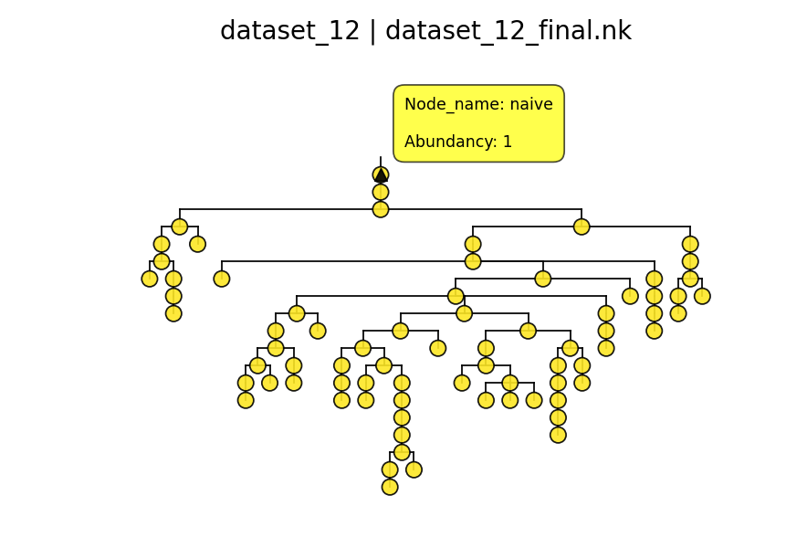
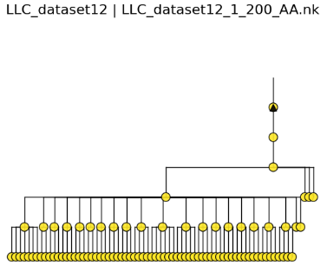
Features based Amino-acid based

Slide 13
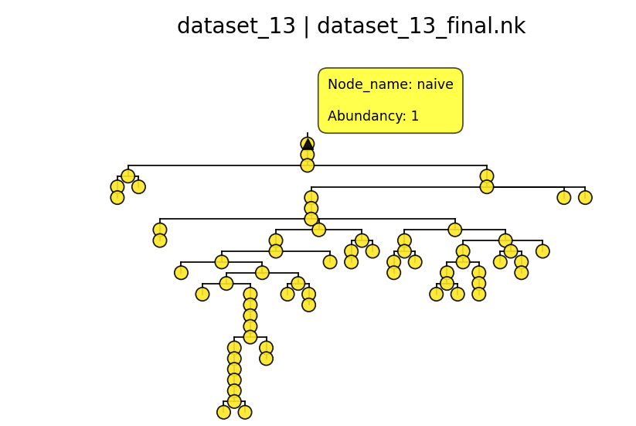
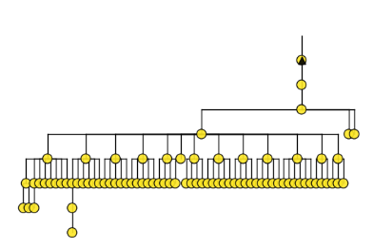
Features based Amino-acid based

Slide 14
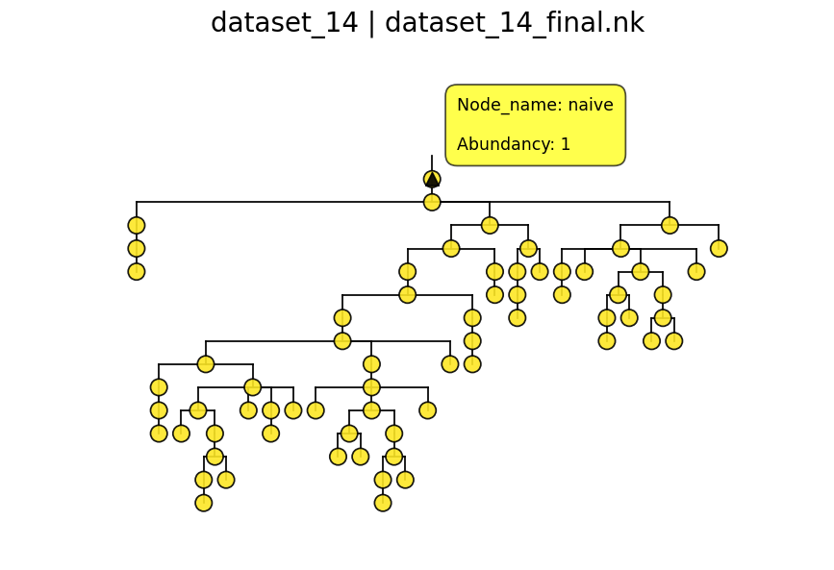
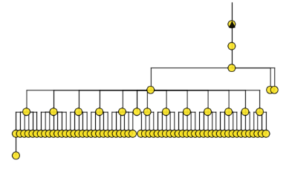
Features based Amino-acid based

Slide 15
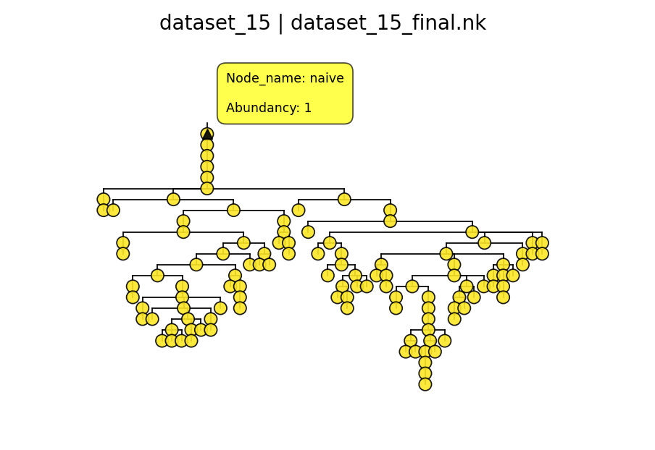
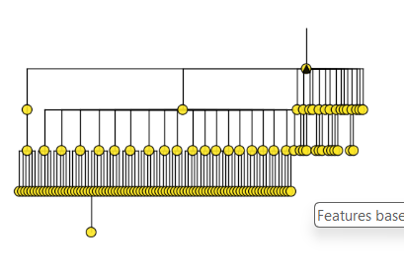
Features based Amino-acid based

Slide 16
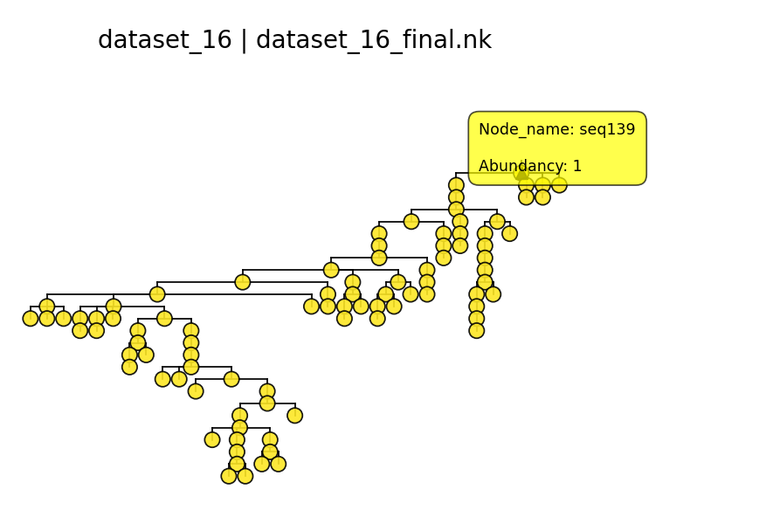
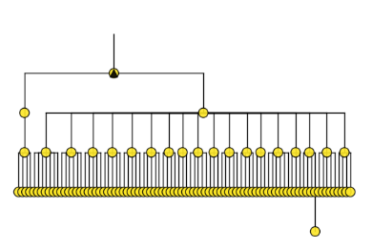
Features based Amino-acid based

Slide 17
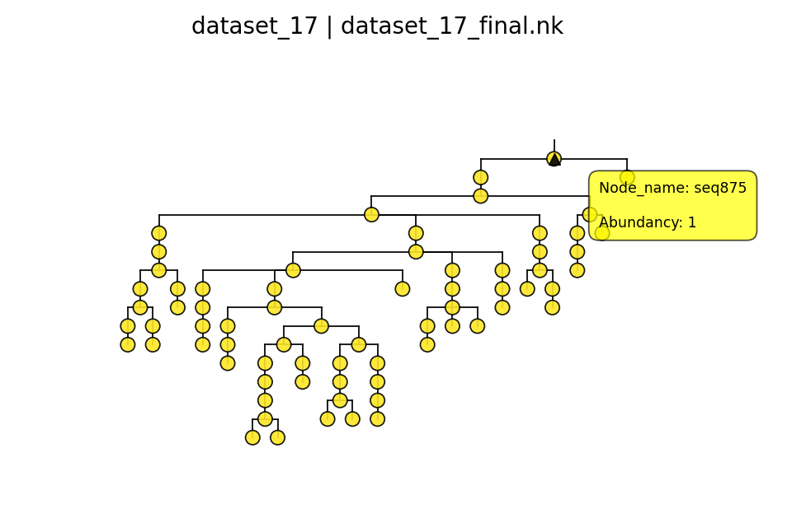
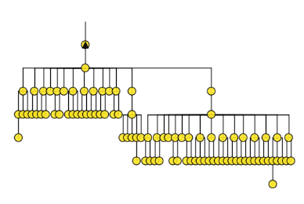
Features based Amino-acid based

Slide 18
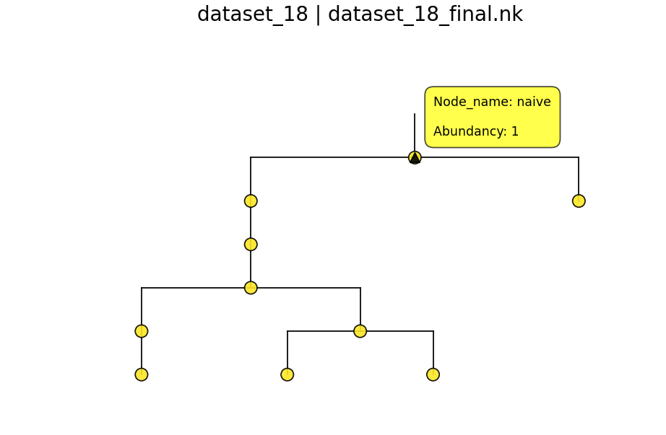
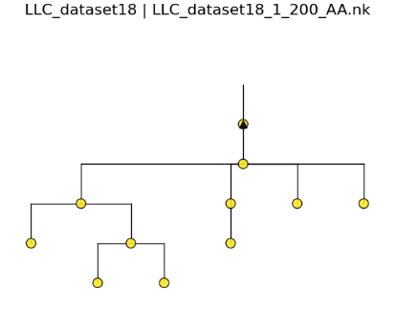
Features based Amino-acid based

Slide 19
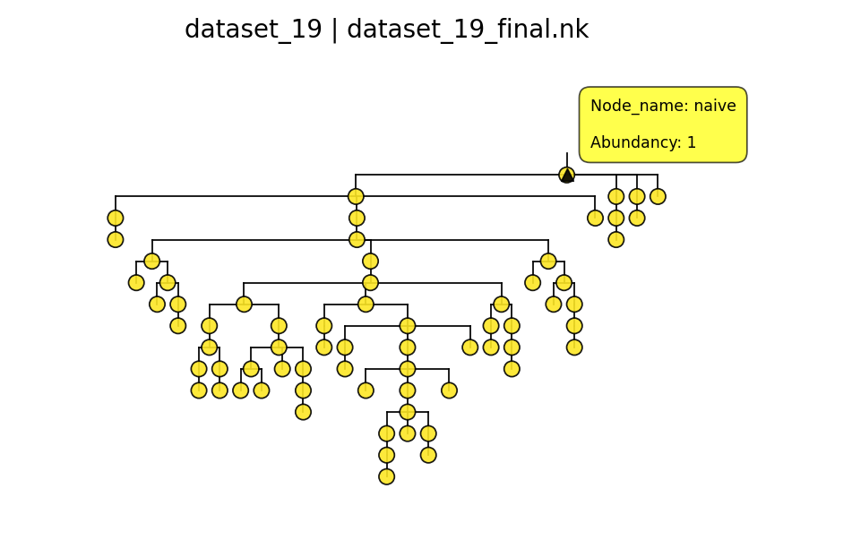
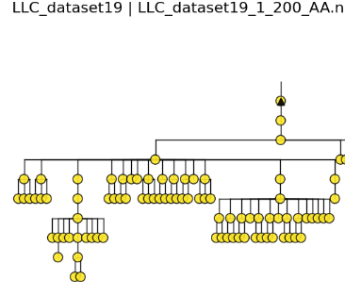
Features based Amino-acid based

Slide 20
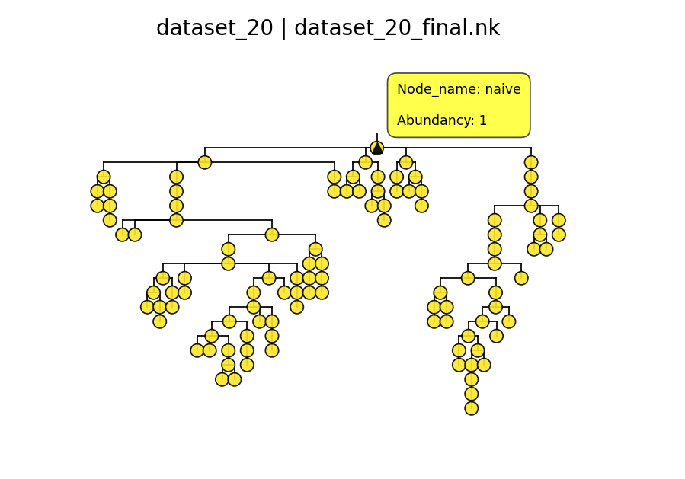
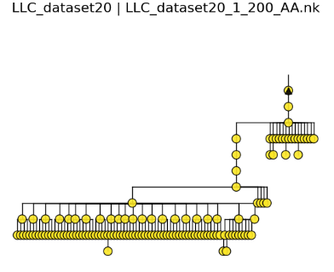
Features based Amino-acid based

Slide 21
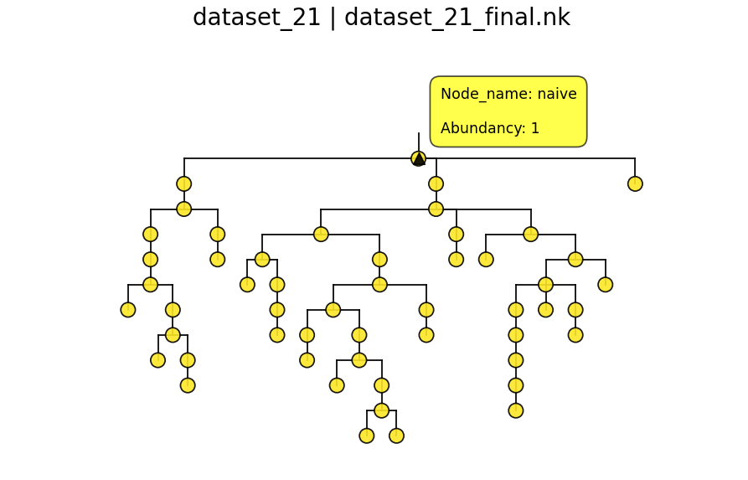
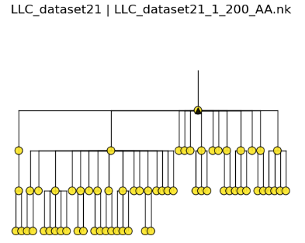
Features based Amino-acid based

Slide 22
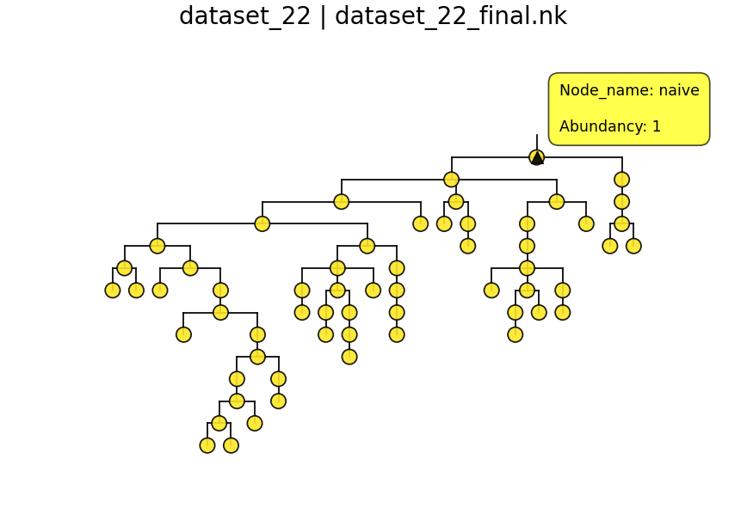
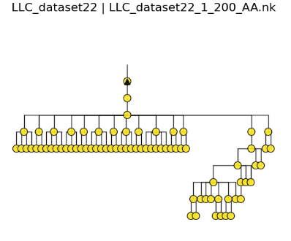
Features based Amino-acid based

Slide 23
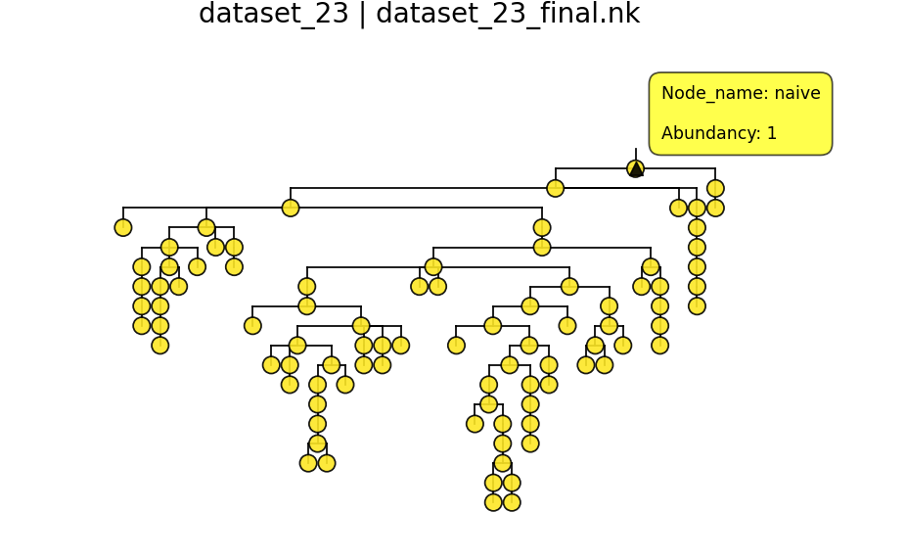
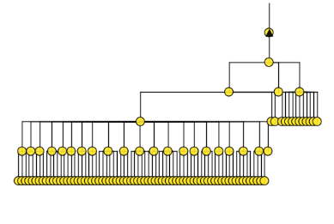
Features based Amino-acid based

Slide 24
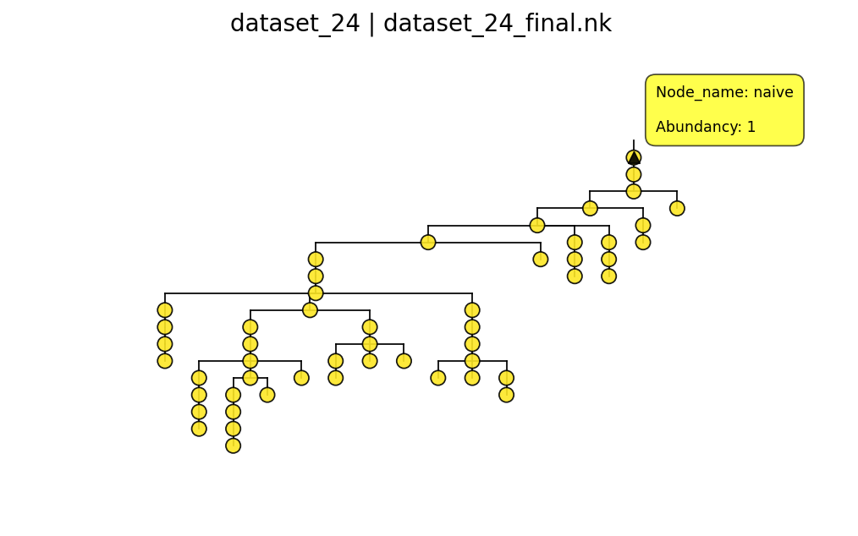
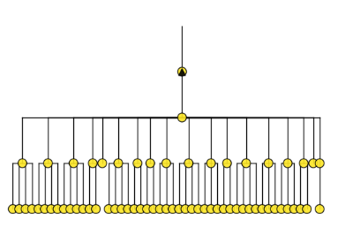
Features based Amino-acid based

Slide 25
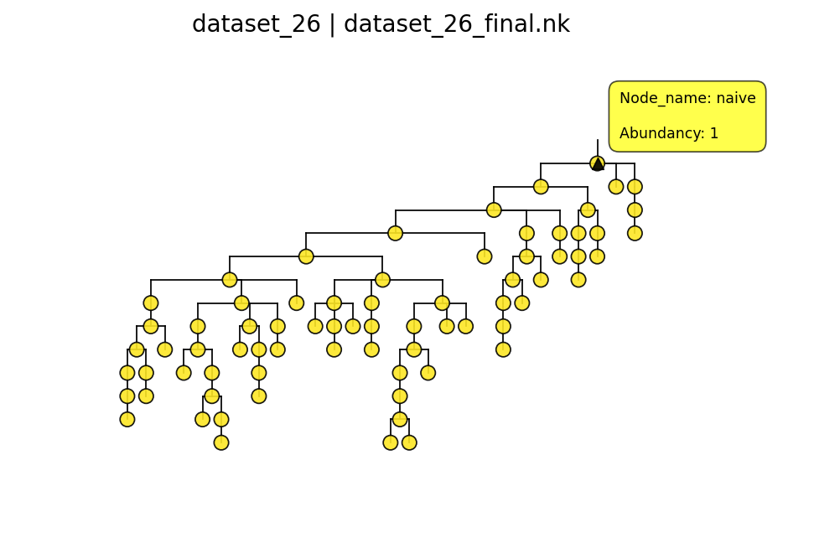
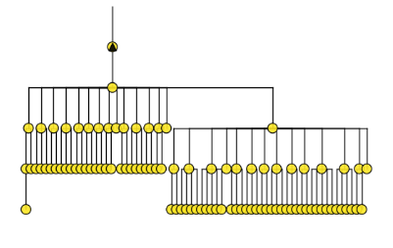
Features based Amino-acid based

Slide 26


Features based Amino-acid based

Slide 27


Features based Amino-acid based

Slide 28


Features based Amino-acid based

Slide 29


Features based Amino-acid based

Slide 30


Features based Amino-acid based

Slide 31


Features based Amino-acid based

Slide 32


Features based Amino-acid based

Slide 33


Features based Amino-acid based

Slide 34


Features based Amino-acid based

Slide 35


Features based Amino-acid based

Slide 36


Features based Amino-acid based

Slide 37


Features based Amino-acid based

Slide 38


Features based Amino-acid based

Slide 39


Features based Amino-acid based

Slide 40


Features based Amino-acid based

Slide 41


Features based Amino-acid based

Slide 42


Features based Amino-acid based

Slide 43


Features based Amino-acid based

Slide 44


Features based Amino-acid

Slide 45


Features based Amino-acid based

Slide 46


Features based Amino-acid based

Slide 47


Features based Amino-acid based

Slide 48


Features based Amino-acid based

